Slide 1


Green Pace Security Policy
Security Policy Presentation
Charles Adkins

Slide 2

DEFENSE IN DEPTH
This policy outlines and emphasizes the core security principles: C/C++ secure coding standards, data encryption standards, and triple-A standards. Through implementation and enforcement, vulnerabilities can be greatly minimized.

Slide 3
THREATS MATRIX
The highest priority threats should be prioritized.
The low priority threats, although less probable, are still a concern but take less precedence over higher priority threats.
Likely INT-030-C STR-030-C OOP-052-CPP STR-038-C | Priority STR-038-C – P27 STR-002-C – P18 MEM-053-CPP – P18 OOP-052-CPP – P9
Low priority ERR-006-C – P4 INT-035-C – P2 DCL-012-C – P1 | Unlikely DCL-012-C ERR-006-C

Slide 4
SECURITY PRINCIPLES
Validate Input Data
Heed Compiler Warnings
Architect and Design for Security Policies
Keep It Simple
Default Deny
Adhere to the Principle of Least Privilege
Sanitize Data Sent to Other Systems
Practice Defense in Depth
Use Effective Quality Assurance Techniques
Adopt a Secure Coding Standard

Slide 5
CODING STANDARDS
Implement abstract data types using opaque types
Ensure that unsigned integer operations do not wrap
Do not attempt to modify string literals
Sanitize data passed to complex subsystems
Explicitly construct and destruct objects when manually managing object lifetime
Understand the termination behavior of assert() and abort()
Handle all exceptions
Do not delete a polymorphic object without a virtual destructor
Use correct integer precisions
Do not confuse narrow and wide character strings and functions

Slide 6
ENCRYPTION POLICIES
Encryption in rest - Ensure that data is encrypted when on a disk
Encryption in transit - Ensure that data is encrypted while being transmitted
Encryption in use - Ensure that sensitive data is encrypted at all stages

Slide 7
TRIPLE-A POLICIES
Authentication - Authentication involves confirming the right person is accessing the system.
Authorization - Authorization refers to an authenticated user’s rights and privileges.
Accounting - Accounting is monitoring activities and recording actions for compliance and security purposes.

Slide 8
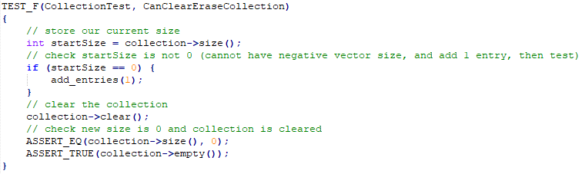
CanClearEraseCollection
Unit Tests

Slide 9
CanOutOfRangeExceptionThrow
Unit Tests

Slide 10
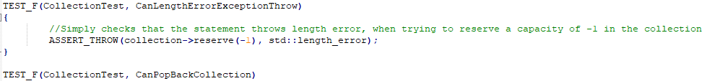
CanLengthErrorExceptionThrow
Unit Tests

Slide 11
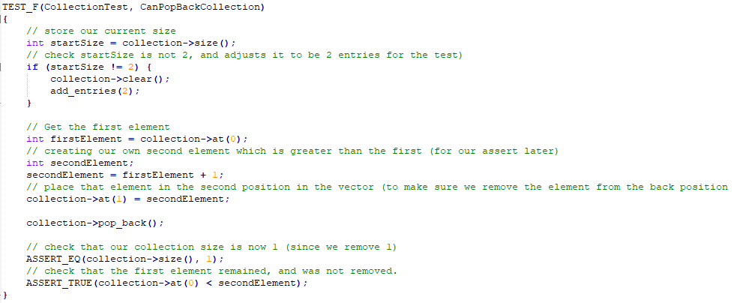
CanPopBackCollection
Unit Tests

Slide 12

AUTOMATION SUMMARY
Automation will be used for the implementation and adherence to the standards defined in this policy.
Automation will enforce standards in several areas within the existing DevOps environment.
This will ensure there are consistent and quality-driven enforcement efforts taking place throughout the environment as a whole.

Slide 13
TOOLS
The DevSecOps Pipeline refers to integrating security into your software development life cycle. ¹
Tools For Automation:
Parasoft C/C++test – Used during the design, verify/test stage in pre-production. Used during the transition/health check and maintain and stabilize stage in post-production.
LoadNinja – Used in the verify and test pre-production for stress testing. Used during the maintain and stabilize in post-production,
Logentries – Used during the monitor and detect stage in post-production, to automate information logging.
Intruder – Used during transition and health check stage of post-production to perform penetration tests.

Slide 14
RISKS AND BENEFITS
Pros
Preventative in nature
Saves money long-term
Protects reputation and customer trust
Cons
Initial Costs
Technical debt and professional expertise required
Deployment and implementation requires effort and time
The pros of acting early and implementing security protocols plus automation far outweigh the cons. The potential loss of value in the form of trust or reimbursement exceeds any upfront cost. The costs in time and expertise are arbitrary when it comes to secure and reputable organization that can be trusted.

Slide 15
RECOMMENDATIONS
Incident Response
Trusted sources
Responsibilities

Slide 16
CONCLUSIONS
Keep it simple
Use correct integer precision
Do not confuse narrow and wide character strings and functions
Handle all exceptions
Validate input data
Default deny
Sanitize data
Follow and review defense in depth strategies, understand and enforce security policies

Slide 17
REFERENCES
Foster, S. (n.d.). DevSecOps Pipeline Overview: DevSecOps Simplified. Perforce Software. Retrieved April 17, 2024. from https://www.perforce.com/blog/kw/devsecops-pipeline-overview#:~:text=Free%20Klocwork%20Trial-,What%20Is%20a%20DevSecOps%20Pipeline%3F,secure%20software%20faster%20and%20easier
Intruder. (2024). An Effortless Vulnerability Scanner. Intruder. Retrieved April 18, 2024 from https://www.intruder.io/
LoadNinja. (n.d.). Create and Run Load Tests in Half the Time. LoadNinja. Retrieved April 16, 2024 from https://loadninja.com/
Logentries. (2024). Log Management & Analysis Software Made Easy. Logentries. Retrieved April 16, 2024 from https://logentries.com/
Parasoft. (2023.) C++test - Check C++ and C Code for Compliance. Parasoft. Retrieved April 17, 2024 from https://www.parasoft.com/products/parasoft-c-ctest/

